Slide 1

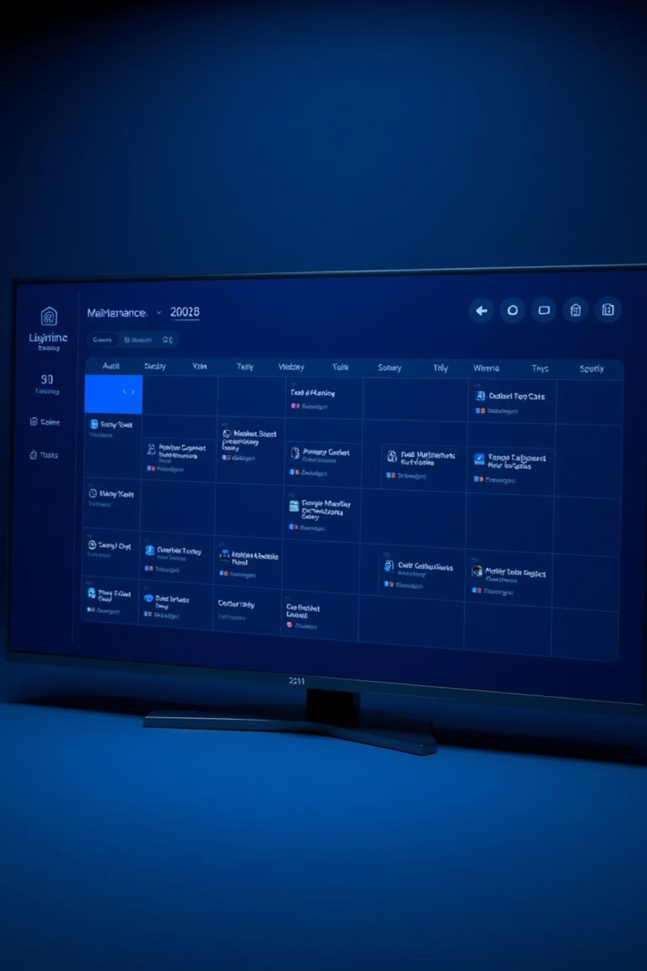
Maintenance Scheduling System
Streamlining Equipment Maintenance & Scheduling
Presented by: Faizan Shahid
Mentored by: Shahzad Javaid

Slide 2




Introduction: Why This System Matters
The Maintenance Scheduling System is a web-based platform designed to revolutionize how organizations manage equipment maintenance tasks and technician assignments.
Timely Maintenance
Automated Efficiency
Ensures equipment upkeep, minimizing unexpected breakdowns and extending asset lifespan.
Reduces manual effort through smart scheduling and task assignment, boosting operational efficiency.
Intuitive Dashboards
Robust Security
Provides clear, easy-to-use interfaces for admins and technicians to manage tasks effectively.
Strengthens data integrity and access control with secure authentication and role-based permissions.

Slide 3




Project Overview: Core Capabilities
This system combines modern web technologies with robust software engineering principles to deliver a scalable and reliable maintenance solution.
Equipment Lifecycle Management
Flexible Scheduling
Admins can register, track, and manage comprehensive maintenance records for all equipment.
Supports both automated periodic schedules and manual, one-time task creation.
Technician Task Assignment
Secure Access Control
Tasks are easily assigned to technicians, with real-time progress monitoring.
Role-based access ensures that users only interact with relevant functionalities, maintaining data security.

Slide 4
Key Modules & Features
Equipment Management
Technician Task Management
Register, update, or archive equipment with detailed attributes.
Assign tasks to specific technicians.
Technicians can view, log notes, upload documents, and mark completion.
Link equipment with workshop locations and types.
View detailed maintenance history per equipment.
Maintain detailed task logs.
Maintenance Scheduling
User Management
Create periodic or one-time schedules.
Role-based login for Admin and Technician.
Automatically generate upcoming tasks.
Admins can manage technician accounts (CRUD).
Highlight overdue tasks to admins.
Dashboard & Notifications
Visualize upcoming and overdue tasks.
Monitor technician activity and system performance.

Slide 5






Technology Stack: Building on a Modern Foundation
The system is built with a modern and reliable technology stack, ensuring performance, scalability, and maintainability.
Frontend
Backend
React with TypeScript for a robust UI, Redux for state management.
.NET Core Web API to handle complex business logic.
Database Access
Authentication
Entity Framework Core (ORM) for efficient data operations.
Microsoft Identity with JWT for secure token-based login.
Database
APIs
SQL Server for reliable and structured data storage.
REST API for seamless communication between layers.

Slide 6
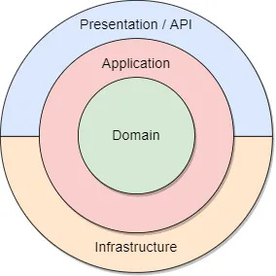
Architecture: Clean, Scalable, Maintainable
The project follows a Clean Architecture approach to ensure a highly testable, modular, and flexible system that is easy to extend.
UI Layer
React + TypeScript frontend, user interactions.
Application Layer
Business logic and use cases, orchestrates operations.
Domain Layer
Core entities and rules, independent of infrastructure.
Infrastructure Layer
Database and external services, implements interfaces.

Slide 7
Design Patterns: Ensuring Best Practices
To promote robust, clean code and maintainability, the following key design patterns were implemented:
Repository Design Pattern
Dependency Inversion Principle (DIP)
This pattern abstracts data access logic, making the system independent of the underlying database technology. It centralizes common data access functionality, simplifies testing, and improves overall modularity.
DIP ensures that high-level modules do not depend on low-level modules; instead, both depend on abstractions. This approach enhances flexibility, testability, and reduces coupling within the system, making it easier to change components without affecting others.

Slide 8






System Workflow: Seamless Operations
The structured workflow ensures smooth interaction and efficient management of maintenance tasks between administrators and technicians.
Admin Setup
Admin registers equipment and defines maintenance schedules.
Task Generation
System automatically generates tasks or flags overdue items.
Assignment
Admin assigns specific tasks to available technicians.
Technician Action
Technicians log activities, upload documents, and mark completion.
Progress Monitoring
Admin monitors real-time progress through intuitive dashboards.
Secure Access
Authentication via Microsoft Identity & JWT secures all interactions.

Slide 9
Conclusion: Driving Maintenance Excellence
The Maintenance Scheduling System is a comprehensive, scalable solution designed to optimize equipment management and enhance operational efficiency for diverse organizations.
Centralized Management
Streamlines the oversight of all equipment and maintenance activities from a single platform.
Reduced Downtime
Enables proactive scheduling, significantly minimizing equipment failures and operational interruptions.
Improved Accountability
Provides detailed logging of all tasks and technician activities, ensuring transparency and trackability.
Robust Security
Leverages Microsoft Identity & JWT for strong authentication and secure data access.
Scalable & Adaptable
Built to grow with your organization, easily configurable for various industry needs and sizes.

Slide 10

Thank You!
Questions?

